Slide 1
Introduction to SACE
Your pathway to universities globally
Notes:
Hello.
Thank you for your interest in SACE.
In the next few minutes I’d like to explain some of the basics about SACE, what makes it such a world-class program, and how it’s an outstanding pathway for students to gain entry to universities around the world.

Slide 2
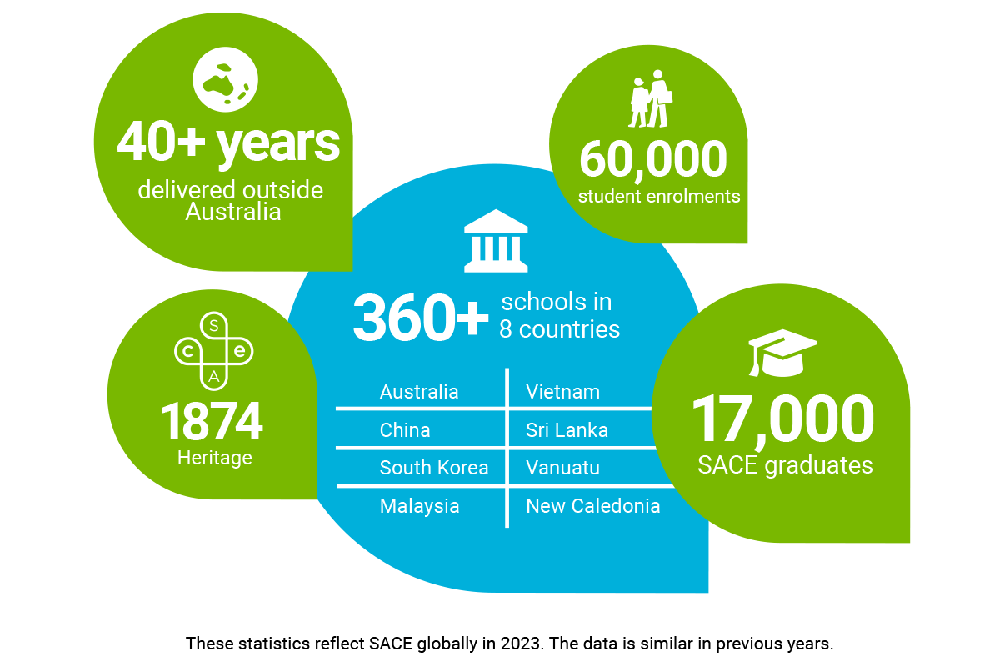
Strong credentials.
A proud history of success.
SACE is the South Australian Certificate of Education.
It’s the state’s official Senior Secondary Certificate
of Education – accepted worldwide.
Notes:
SACE – the South Australia Certificate of Education - is the official Senior Secondary Certificate of Education in the state of South Australia.
It’s accepted by leading universities right around the world.
The program is certified by the SACE Board of South Australia - a Statutory Authority (a government agency) of the Government of South Australia.

Slide 3
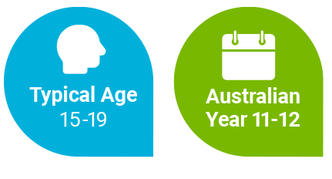
Who has SACE been developed for?
A high quality program designed for students aged 15-19.
It’s the equivalent of Years 11 and 12 in Australia.
Notes:
SACE is a high quality program designed for students typically aged from 15-19 years.
It’s the equivalent of the Year 11 and 12 curriculum in Australian schools.

Slide 4
What makes SACE different?

Slide 5

SACE helps develop the whole person
A focus on academic excellence as well as practical learning which goes far beyond the textbooks to develop valuable study and life skills:
Critical thinking
Working in teams
Adaptable, practical thinking
Research skills
Communication skills
Time-management
Entrepreneurial thinking
SACE helps students
become more resilient
and adaptable.
So they’re better able
to cope and turn challenges
to their own advantage.
Notes:
SACE has a unique focus on developing the whole person.
As well as fostering academic excellence, SACE focuses on teaching students the skills they need for sustained success at university. In their career. And in life.
Success depends on the ability to think critically, work in teams, be adaptable, and confidently take on research challenges.
Communication and teamwork skills, time-management and creative and entrepreneurial thinking are also essential.

Slide 6

A different more ‘real-life’ kind of assessment
Builds
lasting
knowledge
No
cramming
Smaller,
more frequent assessments
Assessment
that brings
out the best
in everyone
Notes:
A different, more ‘real-life’ kind of assessment.
Life is not one big exam, so school assessment shouldn’t be either.
SACE has smaller, more frequent assessments which build lasting knowledge - no cramming for one big exam.
This kind of assessment brings out the best in every individual.

Slide 7

A program better tailored to individual strengths
SACE sets the broad curriculum.
But teachers have the flexibility to adapt lessons and assessment.
And students can choose subjects they’re interested in and demonstrate their learning in different formats formats
Students are encouraged to follow their ambitions and passions, and build on their individual strengths.
Notes:
A program better tailored to individual strengths.
MORE DETAIL:
Teachers can customise the SACE program to match local requirements and to address the preferences and interests of students.
Students are able to demonstrate their learning in different formats. They also have the opportunity to choose topics they are interested in.
The SACE model trusts teachers - who understand their students best - to make informed decisions about the content, sequence and assessment tasks within a framework provided by the SACE Board.

Slide 8
Fundamentals of SACE

Slide 9

A comprehensive two-stage program, usually completed over two years
A diverse choice of subjects spanning:
• Arts
• Business
• Technology
• English (compulsory)
• Health
Teachers help students choose subjects suited to gaining entry to their preferred university course.
• Humanities
• Social Sciences
• Languages
• Mathematics (compulsory)
SACE recognises
prior learning meaning that students may be able to complete the program quicker.
Notes:
NOTE:
*This subject list is customisable so schools can list the subjects they offer and program duration - adaptable according to whether the school delivers SACE as a one-year program, Stage 2 only or as a two-stage program.
MORE DETAIL
SACE students can choose from a diverse range of subjects spanning arts, business, technology, English, health, humanities, social sciences, languages, mathematics, and science.
The SACE program you study mirrors the SACE done by students in Australia.
Speak with your teachers about aligning your subject choices with your interests, planned university studies and career aspirations.

Slide 10




Business pathway example
English as an
Additional Language
General
Mathematics
Accounting
Economics
Business Innovation
I am interested
in accounting and
hope to have
a career in business.
20 Credits
20 Credits
20 Credits
20 Credits
20 Credits
English as an
Additional Language
General
Mathematics
Accounting
Economics
Business Innovation
20 Credits
20 Credits
20 Credits
20 Credits
20 Credits

Slide 11

Medicine/Health Sciences pathway example
English as an
Additional Language
General
Mathematics
Biology
Psychology
Chemistry
I am interested
in science and
hope to have
a career in health.
20 Credits
20 Credits
20 Credits
20 Credits
20 Credits
English as an
Additional Language
Mathematical
Methods
Biology
Psychology
Chemistry
20 Credits
20 Credits
20 Credits
20 Credits
20 Credits

Slide 12
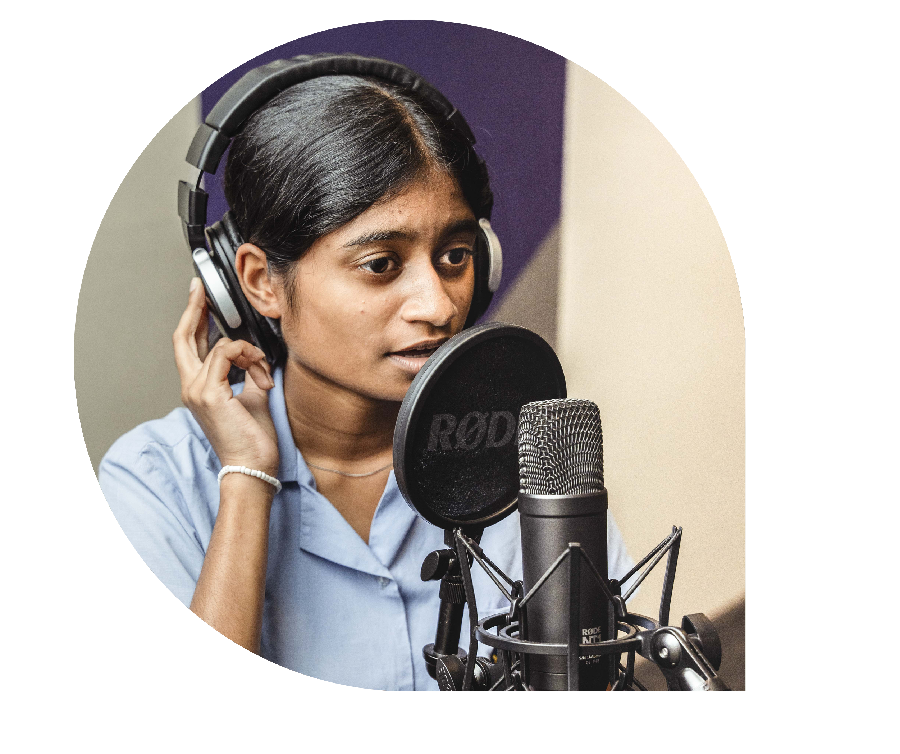
Arts pathway example
English as an
Additional Language
General
Mathematics
Society and Culture
Visual Arts
Business Innovation
I am interested
in the creative industries
and hope to have
a career in the media.
20 Credits
20 Credits
20 Credits
20 Credits
20 Credits
English as an
Additional Language
General
Mathematics
Society and Culture
Visual Arts
Business Innovation
20 Credits
20 Credits
20 Credits
20 Credits
20 Credits

Slide 13
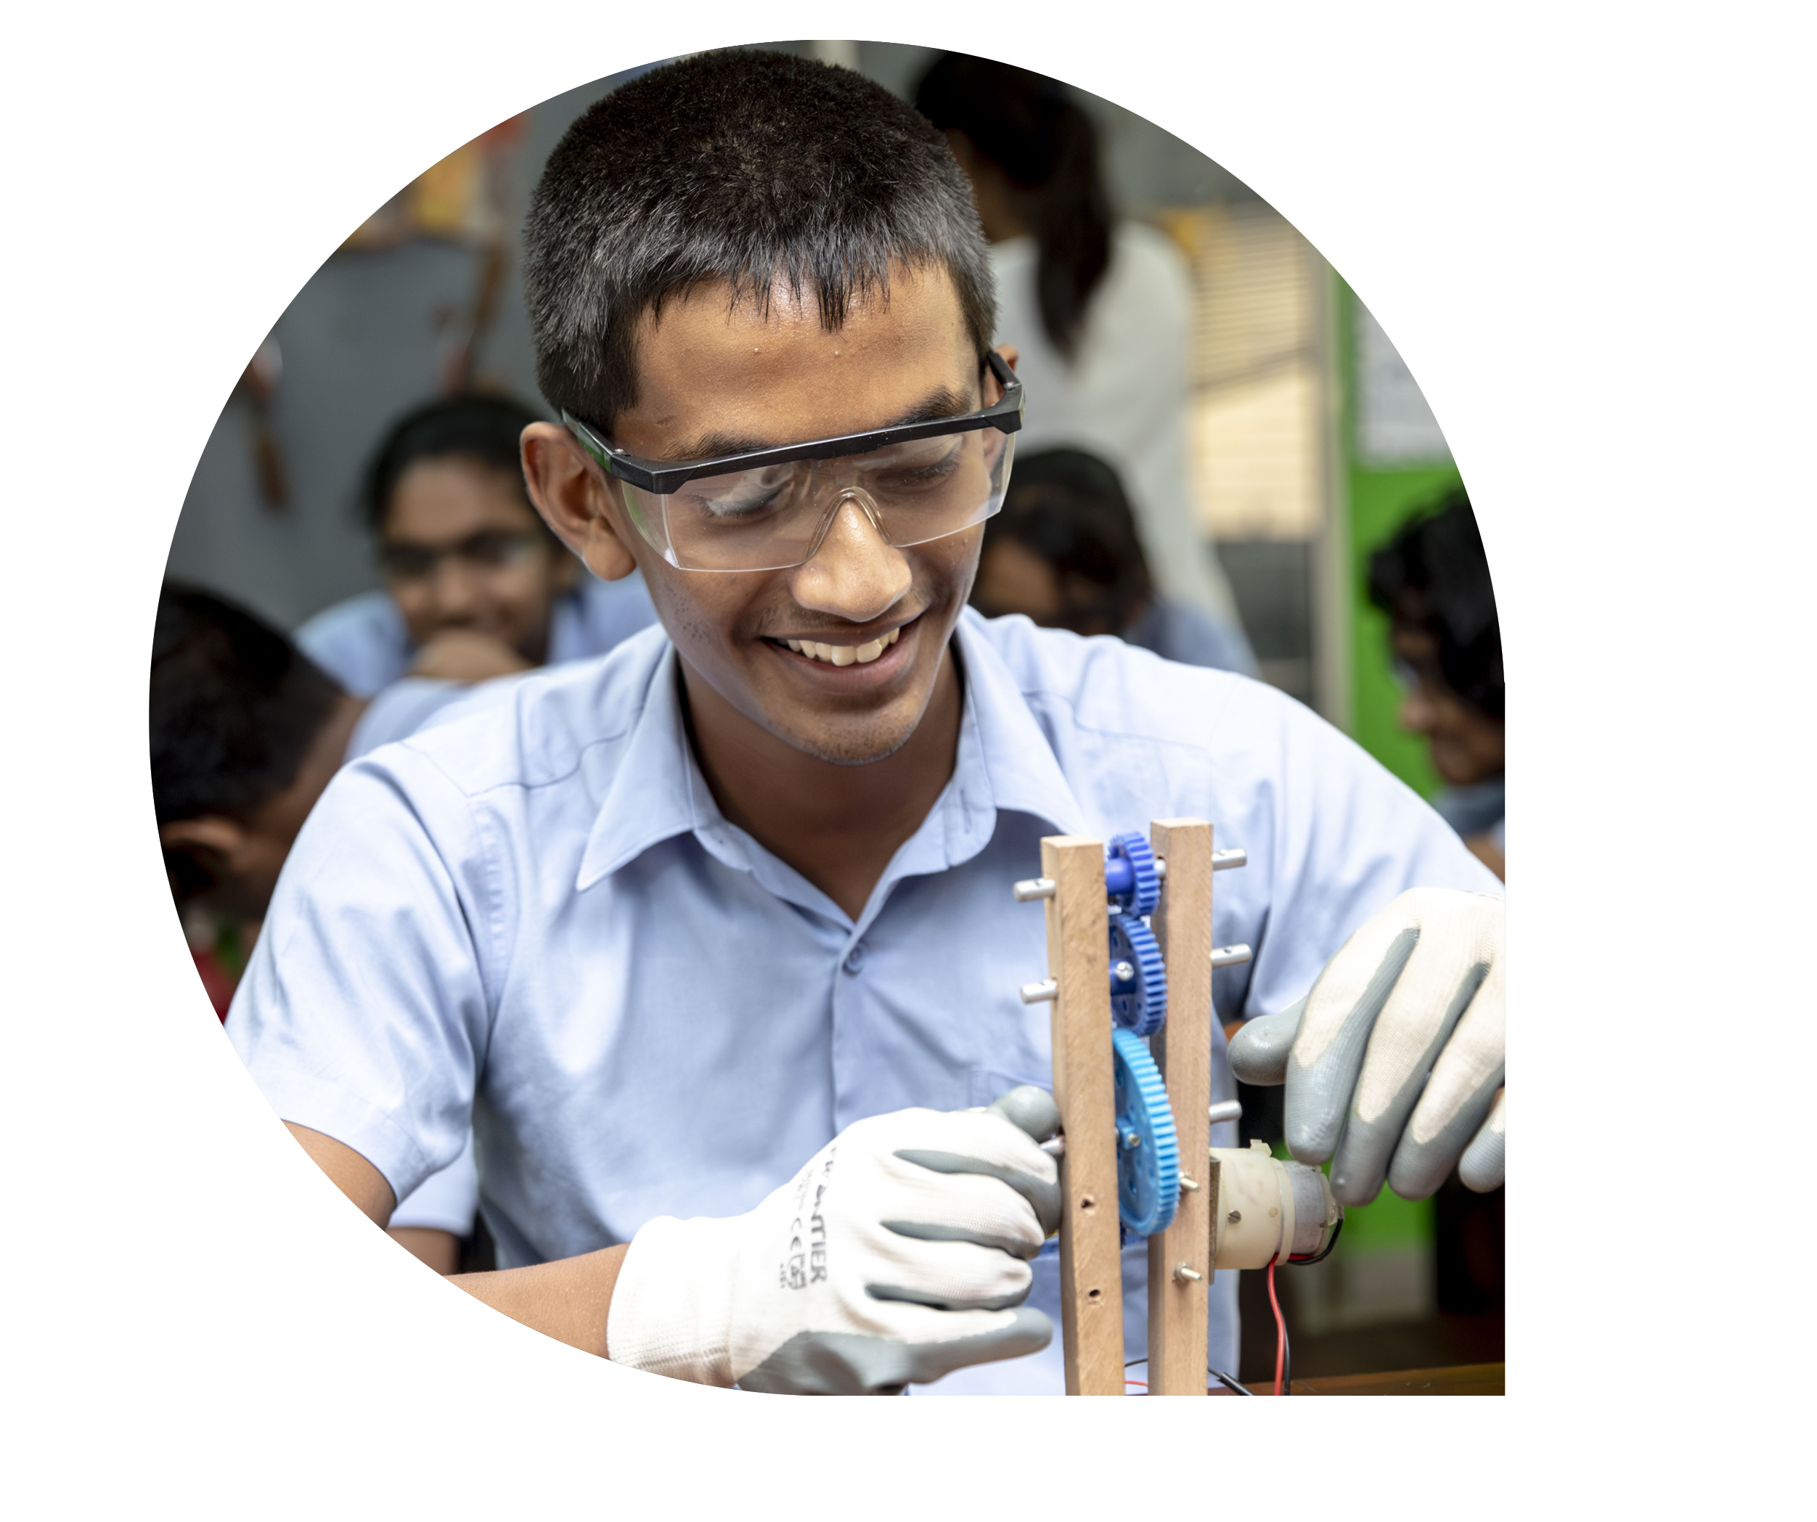
Engineering pathway example
English as an
Additional Language
Mathematics
Earth and
Environment Science
Physics
Chemistry
I am interested
in physics and
hope to have
a career in engineering.
20 Credits
20 Credits
20 Credits
20 Credits
20 Credits
English as an
Additional Language
Mathematical
Methods
Special Mathematics
Physics
Chemistry
20 Credits
20 Credits
20 Credits
20 Credits
20 Credits

Slide 14

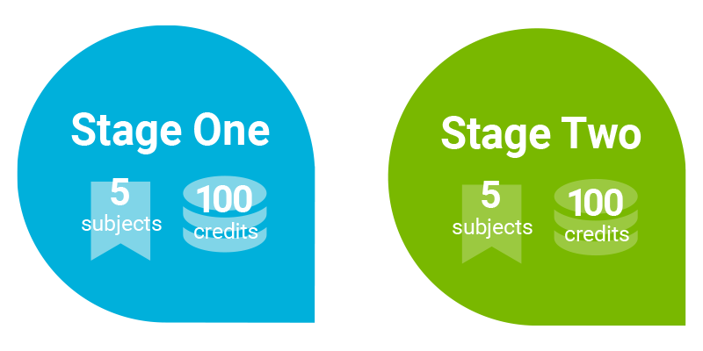
Study in two stages
Each subject has a value of 10 or 20 credits.
Students usually study five subjects per stage.
To successfully complete your SACE, you need 200 credits.
Compulsory requirements are literacy and numeracy.
Students who completed a year of study at a similar level may not need to repeat
this year in Stage One.
Notes:
MORE DETAIL:
Students need to complete 200 credits of learning (5 subjects of 20 credits each).
To successfully complete your SACE, you'll accumulate 200 credits – 100 credits in Stage 1 and 100 credits in Stage 2.
In each stage, you usually study five subjects. Stage 1 subjects provide the essential knowledge for Stage 2.
Subjects HAVE credit values of 10 or 20, reflecting the time commitments.
A 10-credit subject involves 50-60 hours of learning, while a 20-credit subject requires 100-120 hours and typically spans a full year.
There are two compulsory requirements to fulfill for SACE achievement:
- Numeracy Requirement: Complete a mathematics subject or course in either Stage 1 or Stage 2 (10 credits).
- Literacy Requirement: Undertake an English subject or course in either Stage 1 or Stage 2 (20 credits).
If you've completed a year of study at a similar level elsewhere, there's potential for recognition of equivalent learning.
This recognition can speed up your SACE completion, avoiding the need to repeat a year.

Slide 15
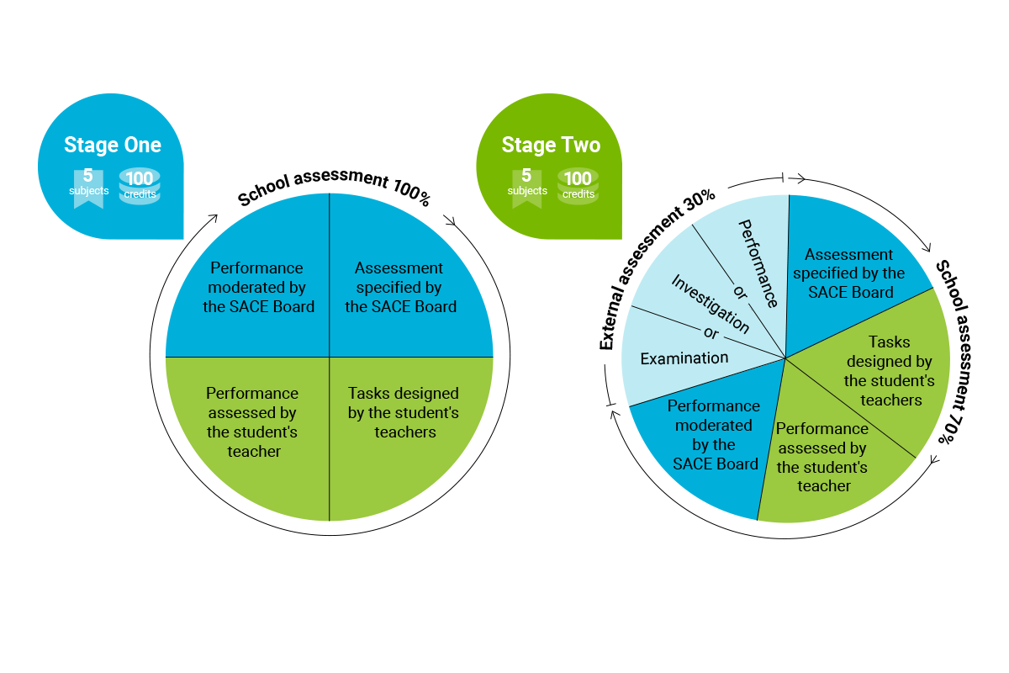
Program structure
Students are regularly assessed throughout their studies.
Smaller, more frequent assessments build lasting knowledge.
Less stress than cramming.
Highly practical assessment uses ‘real-life’ examples and tasks which better reflect what students need to know outside the classroom.
Notes:
The SACE assessment is different to other senior school programs because it includes a school assessment component.
In Stage One, student work is fully assessed by their school.
In Stage Two, student work is 70% assessed by their school and 30% by the SACE Board.
----------
MORE DETAIL:
The SACE assessment model’s main goal is to assess students based on evidence of their learning - gauging what they know and the knowledge they have acquired.
In Stage 1, a student's entire grade (100%) is derived from work completed within the school.
This includes a variety of assessments such as tests, essays, and oral presentations, all aligned with the SACE Subject Outline. Teachers, guided by performance standards, grade assignments on a scale from A to E, with a moderation process ensuring consistency in grading, particularly for compulsory subjects like English and mathematics.
Transitioning to Stage 2, the grading structure changes: 70% of the final grade is determined by school-based assessments marked by teachers according to the SACE Subject Outline and then moderated. The remaining 30% is based on external assessment, which is developed and marked by the SACE Board.
This approach reduces stress for students as, by the time they face exams or external assessments, they've already completed and received grades for a large part (70%) of the SACE.

Slide 16
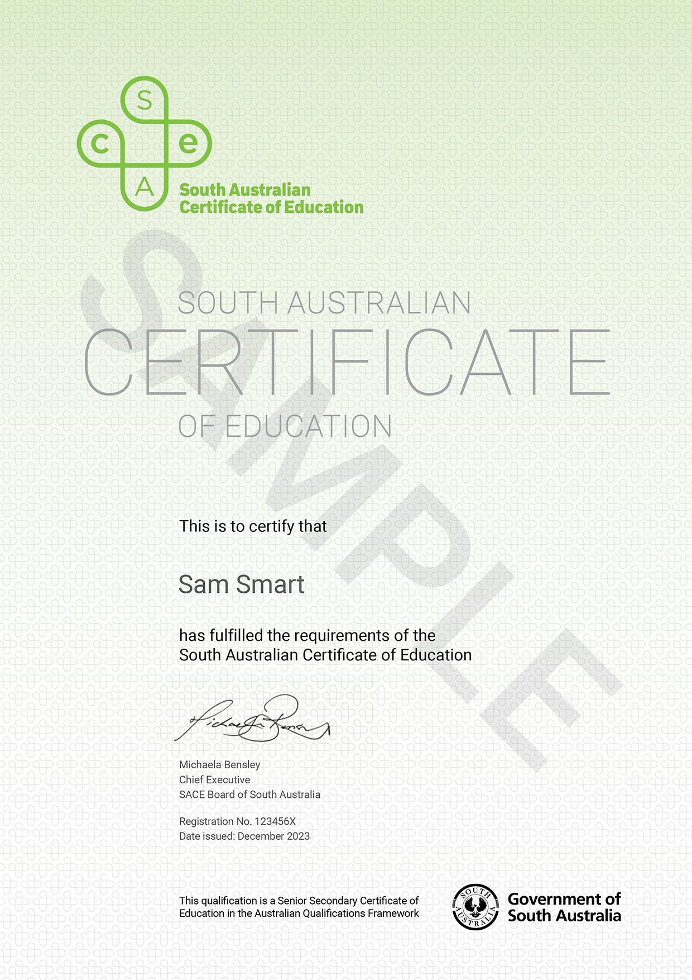
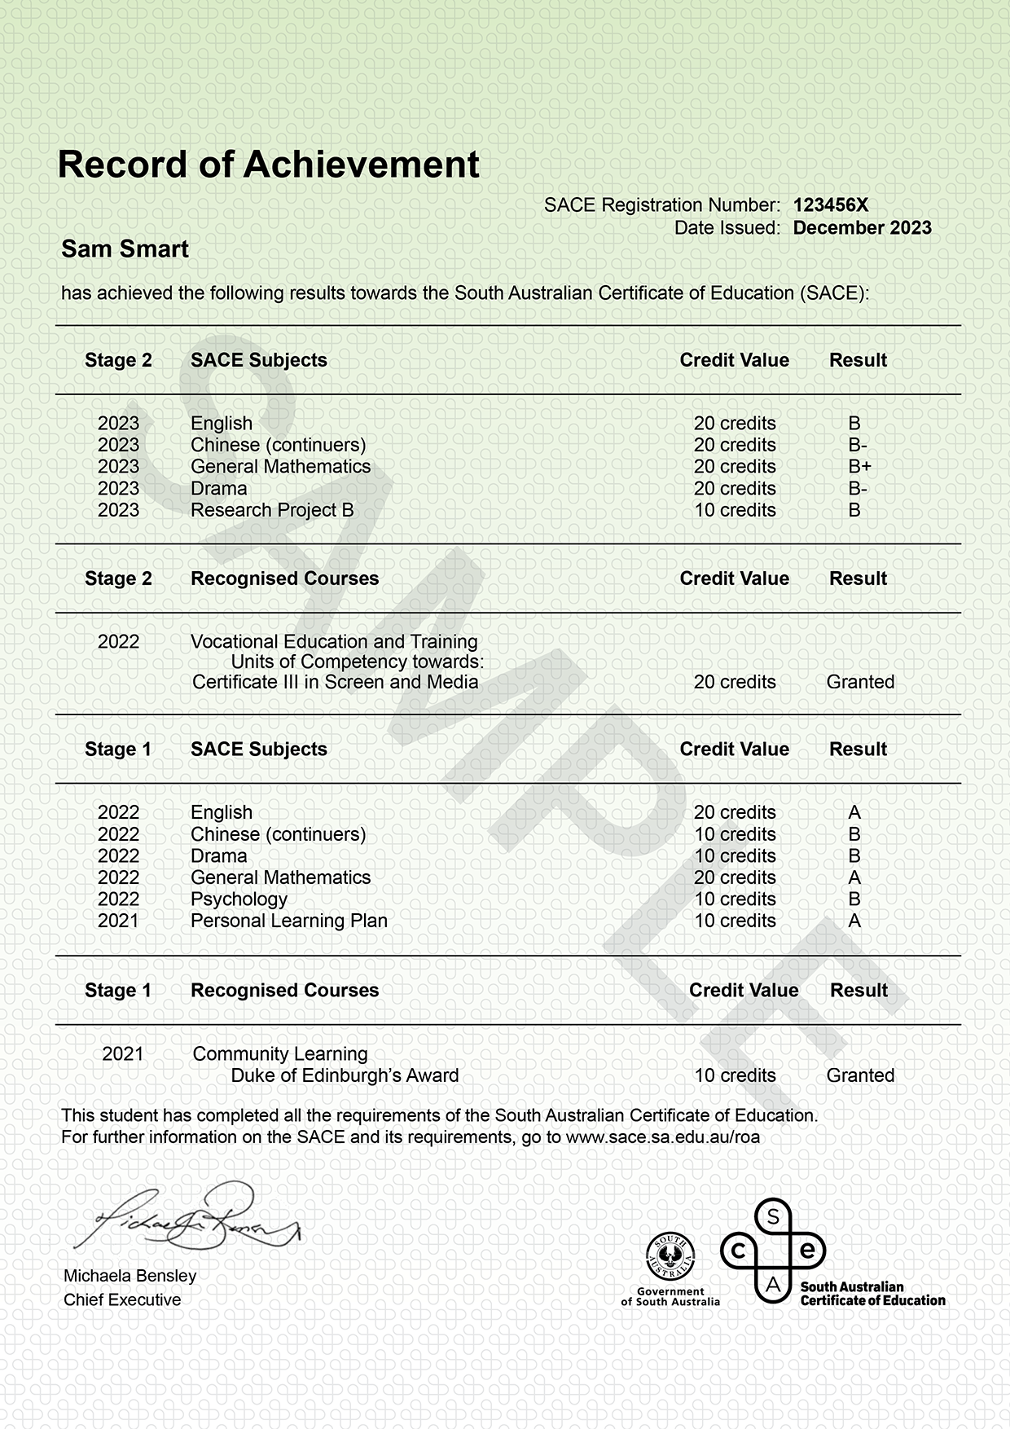
SACE: your passport to university
Notes:
These are the qualifications you’ll receive.
Of course, you get the SACE Certificate – accepted worldwide, and a Record of Achievement.
And because you’ll be studying the same curriculum as students in Australia, you graduate with an ATAR (Australian Tertiary Admission Rank)
They obtain a Tertiary Entrance Statement that includes the Australian Tertiary Admission Rank (ATAR), aligning their academic accomplishments with students in Australia.
ATAR is a rank, between 0.00 and 99.95 calculated based on the student’s results and offers a clear reflection of their academic standing compared to their peers in Australia.
For example, an ATAR of 90.00 means that the student has achieved in the top 10% of students that year.
In essence, the SACE, along with the Tertiary Entrance Statement, ensures that students are equipped with the necessary credentials to pursue diverse pathways to university studies in Australia or worldwide.

Slide 17
Where can SACE take you?

Slide 18
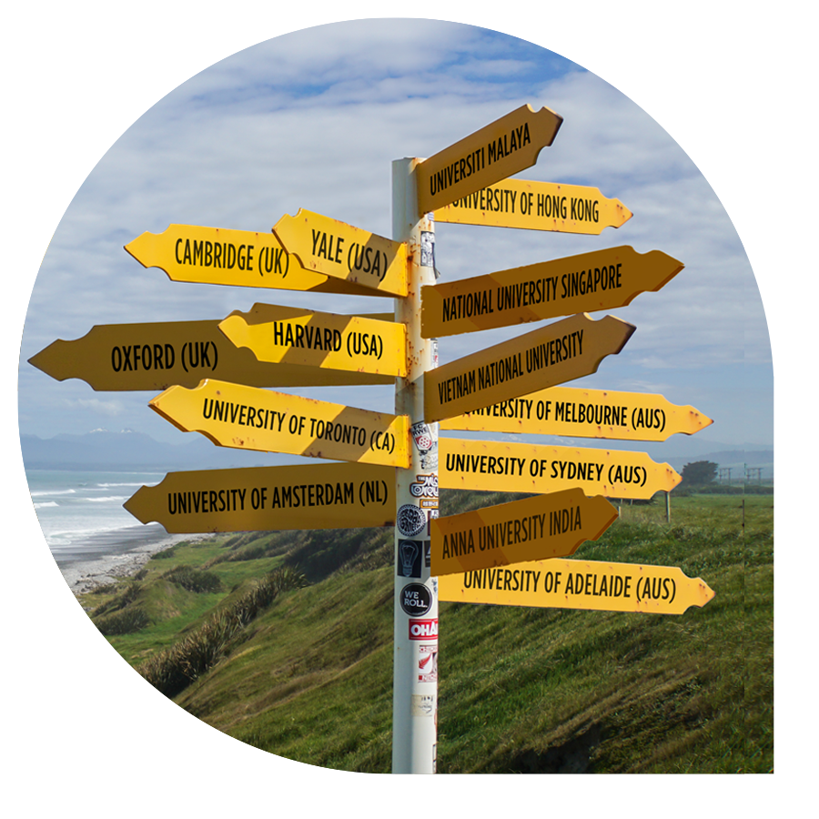
SACE is globally recognised by the world’s top universities
Notes:
Just like other leading curricula, SACE is accepted by universities around the world.
This includes all the top universities in the UK, USA, Canada and Australia. Ivy league in the US, Russell Group like Oxford and Cambridge in the UK, and the prestigious Group of Eight universities in Australia.

Slide 19
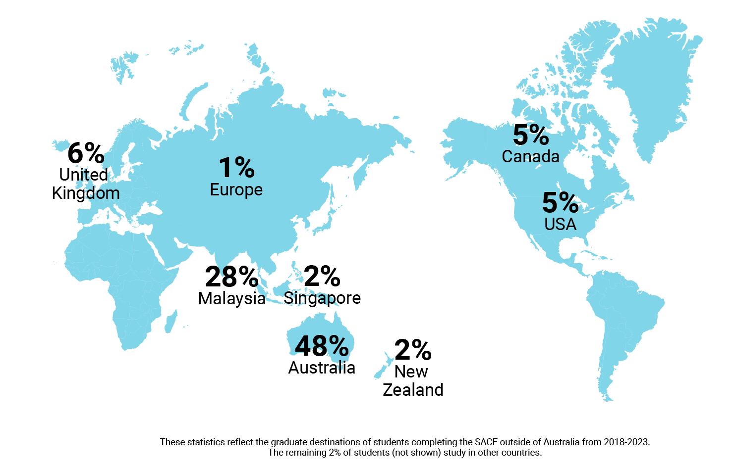
Where SACE graduates go next
Notes:
SACE is a global pathway to university entry and SACE graduates have been accepted into universities across the world.
This map shows where SACE graduates go on to study at university – as percentages.
There really are no limits on where SACE can take you.

Slide 20
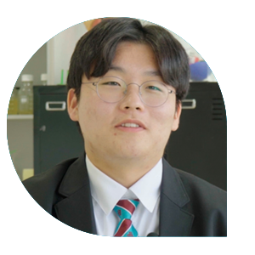

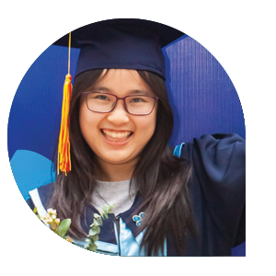
Some recent success stories
One of my favourite things about SACE is the variety of assessment. There’s a really nice balance between tests, practical evaluations and presentations. It keeps me engaged with the content. I plan on studying medicine and the subjects I’m doing, equip me with the
knowledge and skills I need for university.
The SACE teaching staff were very supportive from day one, to help
me achieve my dreams and goals.
The amount of support I received studying SACE was amazing.
I loved it. The teachers were
always there for me, with extra resources and help with problems.
Brian from South Korea
is studying the SACE.
Nadzeem studied the SACE in Malaysia and now studies Accounting & Finance at the University of Sydney.
Van from Vietnam, gained
a full scholarship to Washington State University.

Slide 21
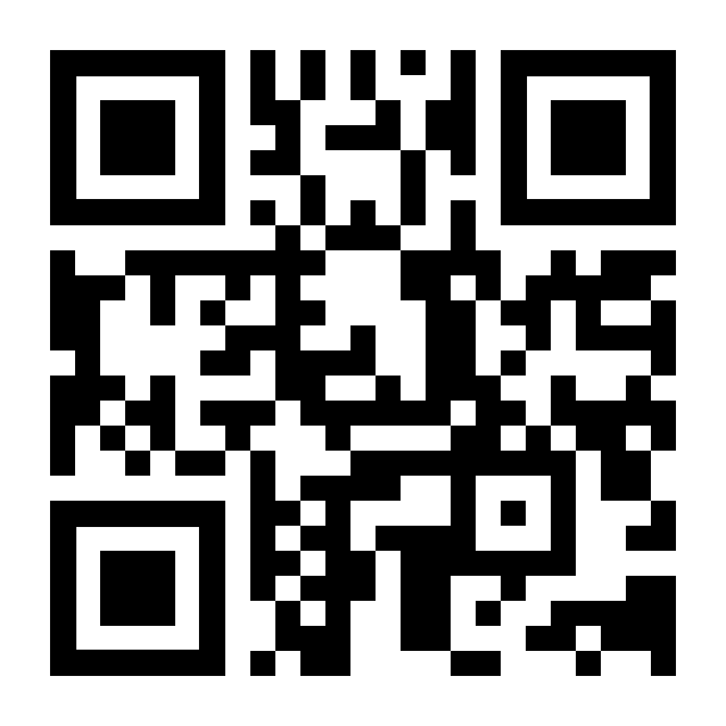
Like to know more?
Speak with your school to find out how to join the SACE program.
For more information about SACE, visit sacei.edu.au or scan this QR code
Notes:
(code will be customised by each school)

